Slide 1

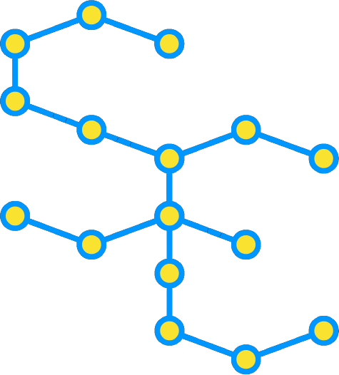

SEUPD@CLEF: Team Kueri on Argument Retrieval for Comparative Questions
Marco Gallo
Odai Mohammad
Giacomo Virginio

Slide 2
Introduction
Task and Data

Slide 3
The task
Argument Retrieval for Comparative Questions
Support users facing some choice problem from "everyday life“
retrieve relevant argumentative passages for either compared object or for both

Slide 4
Collections
Provided by CLEF
Topics-task2.xml which contains the topics.
DocT5Query expanded version of passages.jsonl which contains the documents expanded with queries generated using DocT5Query.
Other collections
Historical stoplists: lucene, smart and terrier;
Custom stoplists:
Kueristop - Stoplist formed by the 400 most concurrent term in the Contents field of the document collection;
Kueristopv2 - Subset of kueristop, obtained by removing from it terms appearing in the Objects field of the topics, except for the very general terms also appearing in lucene stoplist ("in" and "the").
Sentence quality

Slide 5
Manual relevance
The conventional and ideal approach when evaluating the performance of the runs would have been to use last year’s test collection.
Since we did not have access to last year’s corpus we have decided to use this year’s test collection to evaluate our systems, using a qrels file containing relevance feedback manually performed by us.
The qrels file has been built by gathering, for each of the runs performed, the top 5 ranked documents for each topic.

Slide 6
Approach
The system developed

Slide 7
Approach
We developed a system based on Apache Lucene.
The system is made up of the following components:
Parse
Analyze
Index
Search
Relevance Feedback
Reciprocal Ranking Fusion
Argument quality

Slide 8
Parse
This stage is divided into two parts:
Parsing documents, each document has three attributes:
Document ID
Document content
Document DocT5Query
Parsing Topics, each topic has three attributes:
Number
Title
Objects

Slide 9
Analyze
We have built multiple analyzers
to process the documents
perform tokenization
Use different combinations of filters
Use different combinations of stoplists

Slide 10
Index
We performed indexing with different combinations of
Tokenizers
Similarities
For each document we indexed:
The document ID
The document content
The DocT5Query field

Slide 11
Search
Retrieving and preparing the topics for the search.
Defining how to use topics in the search.
We used topics titles in the search by similarity
then we added the topic objects as a MUST clause in the search to act as “filters”
Defining which type of comparison to perform between topics and documents.
Writing the results on a file

Slide 12
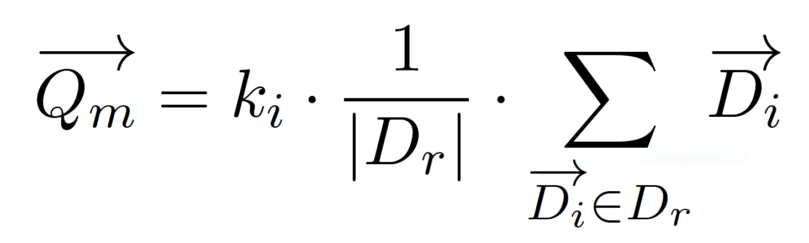
Relevance Feedback (RF)
RF is a technique to perform query expansion
The tokens and their frequency in the relevant documents are retrieved by searching the document by docID and iterating through its termvector.
The tokens used in the search are boosted by their frequency in the document multiplied by the square of the relevance score.
We used the following customized formula for the Rocchio Algorithm

Slide 13
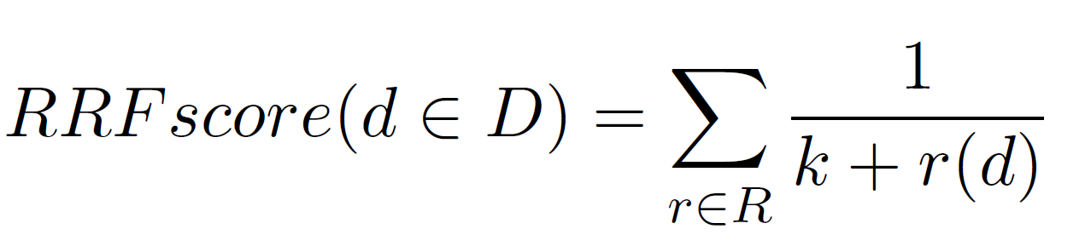
Reciprocal Ranking Fusion (RRF)
Perform RRF using all the runs in .txt documents inside that input directory.
For each documents and for each topic the documents and their respective ranking are collected.
Then document receive a new scoring using the RRF formula

Slide 14
Argument Quality
We decided to make use of IBM Project Debater API, especially the argument quality service of the API.
We used the API, for each passage in the corpus, to gage the quality of the sentence as a text, which means how good they are written.
Then used the obtained scores to rerank the results of the search saved in a run file.

Slide 15
Results
System performance

Slide 16
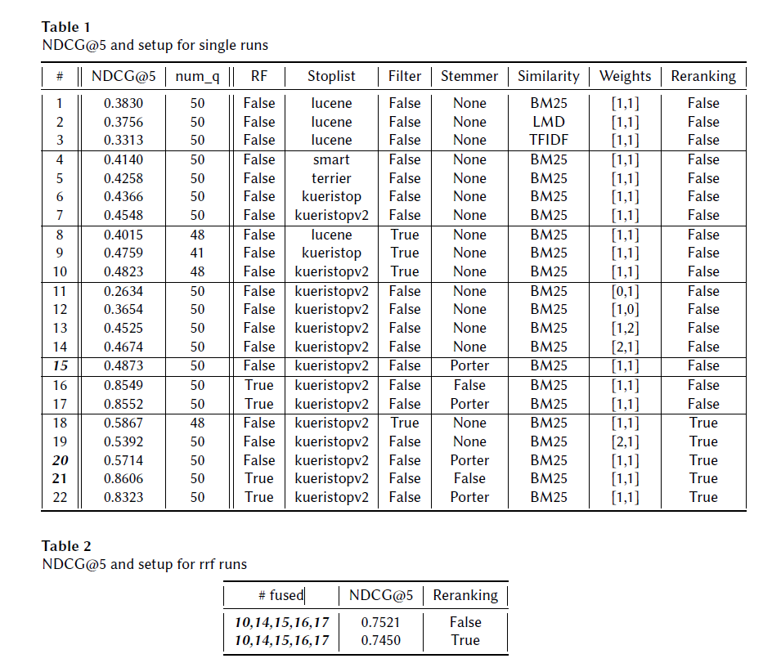
Results

Slide 17
Results
Compare similarity functions
Compare stop lists
Compare impact of filtering
Changing the weight of Contents and DocT5Query fields respectively
Experimenting with adding a stemmer vs not adding one
Relevance Feedback
Reranking with argument quality

Slide 18
Failure analysis
In the first iteration of manual scoring, no relevant documents were found for topic77 “Is it healthier to bake than to fry food?”
Lots of documents retrieved were just ads and were not relevant, but argument quality solves this problem.

Slide 19
Conclusion
And future work

Slide 20
Conclusion
Tested out different techniques and tools studied in lessons, to discover new ones on our own and experiment with their impact in a "real world" application.
Having access to last year’s corpus would allow us for example to
Fine tune BM25 parameters
Fine tune the field weights
Fine tune the boosts for terms in RF
And we could experiment with many more stoplists and stemmers.
In future works it would be interesting to experiment with machine learning and deep learning techniques, that have become the standard in the last decade of information retrieval

Slide 21
Thank you

